Slide 1
Fundraising: Sustained Donor Momentum and Fundraising Best Practices

Slide 2
MODERATORS
Tim Cavanaugh, Paciolan
PRESENTERS
Jake Bajwa, Cincinnati Arts Association
Jennifer Berquist, University of Kansas
Matt Monroe, University of Maryland
Tyler Reichwein, Amplify - Learfield

Slide 3
AGENDA
Introductions
Overview of Fundraising Landscape / Trends
Client Testimonials / Strategy Highlights
Follow Ups
Questions

Slide 4
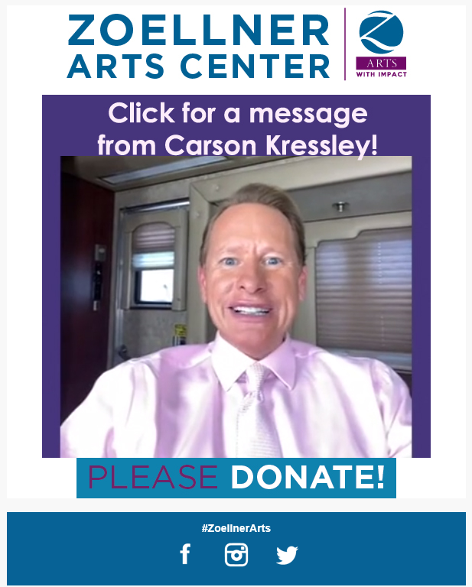
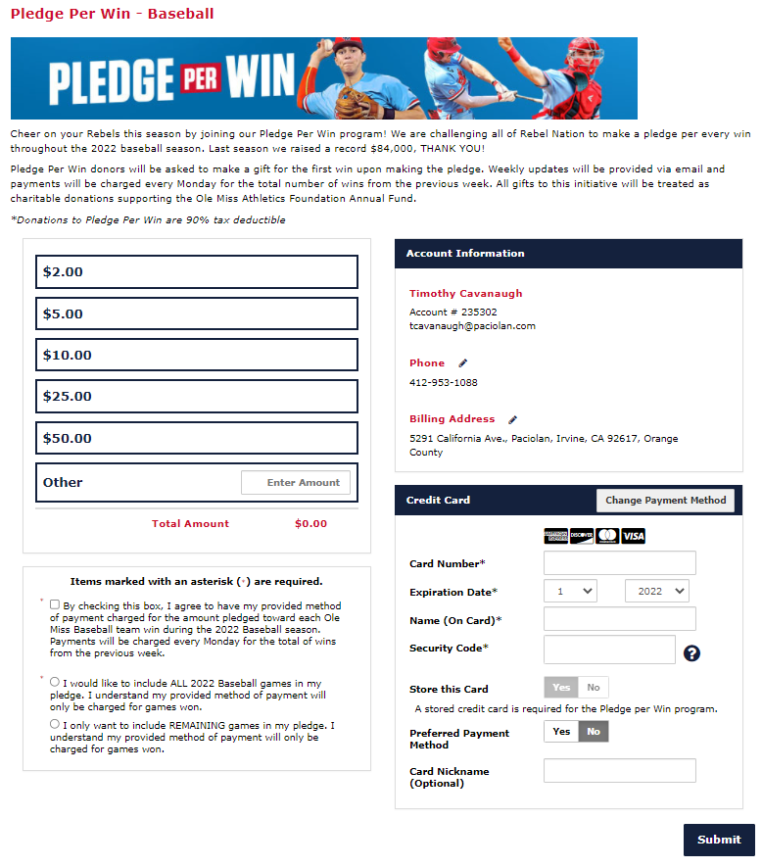
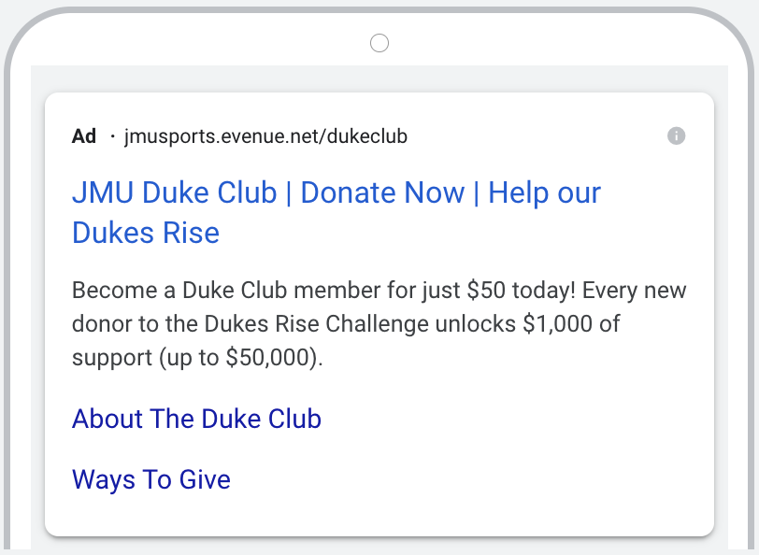
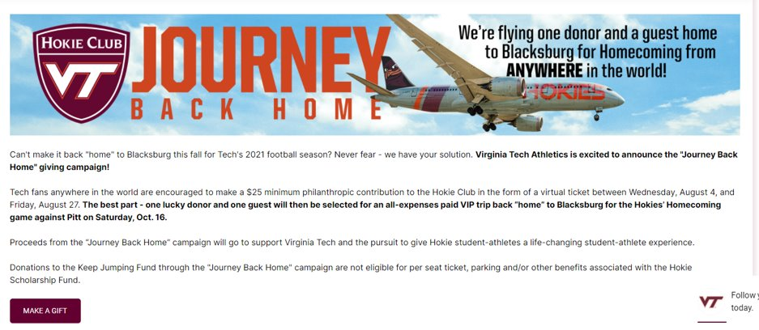
Landscape / Trends

Slide 5
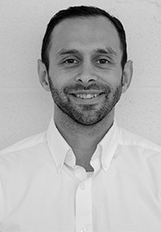
Jake Bajwa
Cincinnati Arts Association

Slide 6
Cincinnati Arts Association
2019 Fundraising Programs & Highlights:
Individual Giving up 17% over Yearly Goal
Corporate Giving was Highest in CAA History
Gala was 2nd Most Successful in CAA History
Education Programming Reached over 100,000 Tri-State Students
675,000 Patrons Across 785 Events

Slide 7

Such Good

Slide 8
Cincinnati Arts Association
The Next 12 Months:
Individual Giving Dropped 52%
Corporate Giving Dropped 40%
Canceled Gala for 2 Years
Education Programming Reach Dropped 50%
300+ Canceled Events Resulting in Millions of Lost Revenue

Slide 9
Cincinnati Arts Association
Solutions:
Marketing Pivot:
  Show announcements & on-sales TO
  Highlighting community arts & Raise the Curtain campaign
Education Programs:
  Virtual programming implemented
Ticketing
  Donation ask in place of refund ask
Increased donation asks and options

Slide 10

Cincinnati Arts Association
Name-A-Seat Campaign Introduction:
Goal
  Reengage & Attract
  Financial
Motivation
  Legacy
  Raise the Curtain

Slide 11
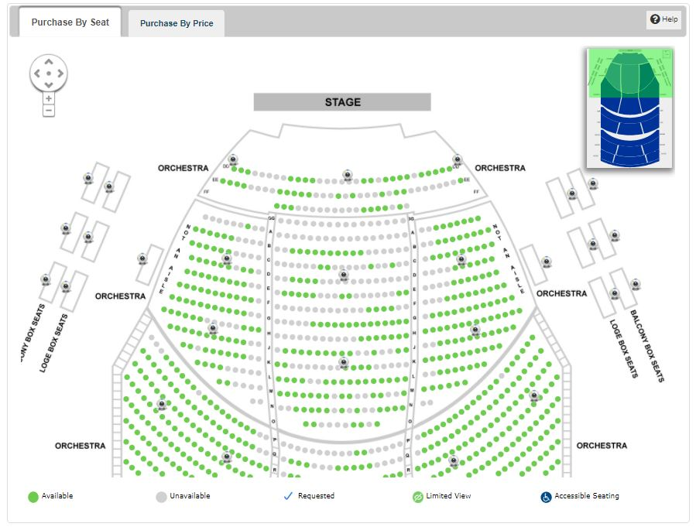
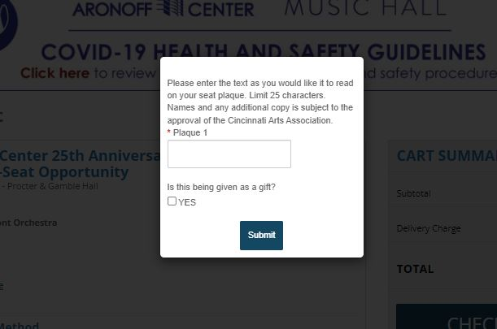
Cincinnati Arts Association
Name-A-Seat Campaign Implementation:
Variable Pricing
  $1000, $750, $500, $250
Online Seat Selection Option
  Personalized Data Collection
$25,000 Goal for 25th Anniversary

Slide 12

Cincinnati Arts Association
Results:
Launched in Mid-November 2020
2 Weeks to Reach $25,000 Goal
Reached $100,000 by End of Fiscal Year
65% are New Donors

Slide 13
Cincinnati Arts Association
Leverage Success & Build Momentum:
Connect & Engage Donors for Continued Support
  Donor “Thank You” Events
  Connect Corporate & Individual Donors
New Fundraising Ideas & Programs
  Program Specific Donation Campaigns
  Stage Floor Campaign

Slide 14
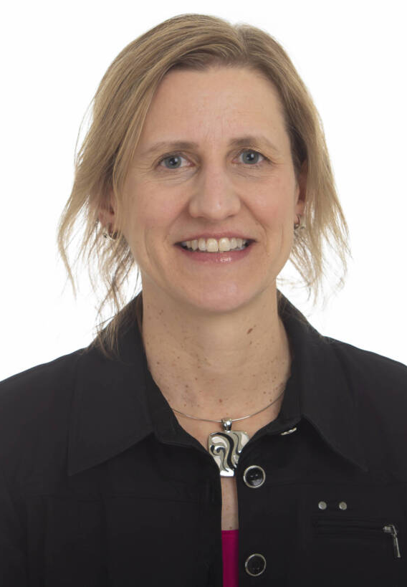
Jennifer Berquist
University of Kansas
Williams Education Fund

Slide 15
Williams Education Fund
Building Donor Momentum:
Auto Renewal opportunity introduction
Implemented two new additional giving campaigns:
  110% and Next Level
Unique Revenue Generating Strategies:
Making the ask for Credit Card Fee Coverage
Introduced Williams Fund 500 Campaign
  500 New Donors for 500 Student-Athletes

Slide 16
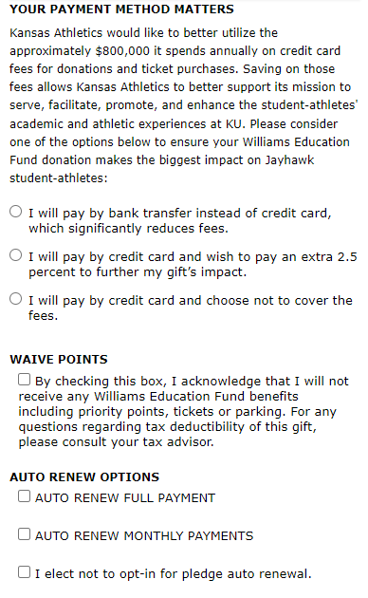
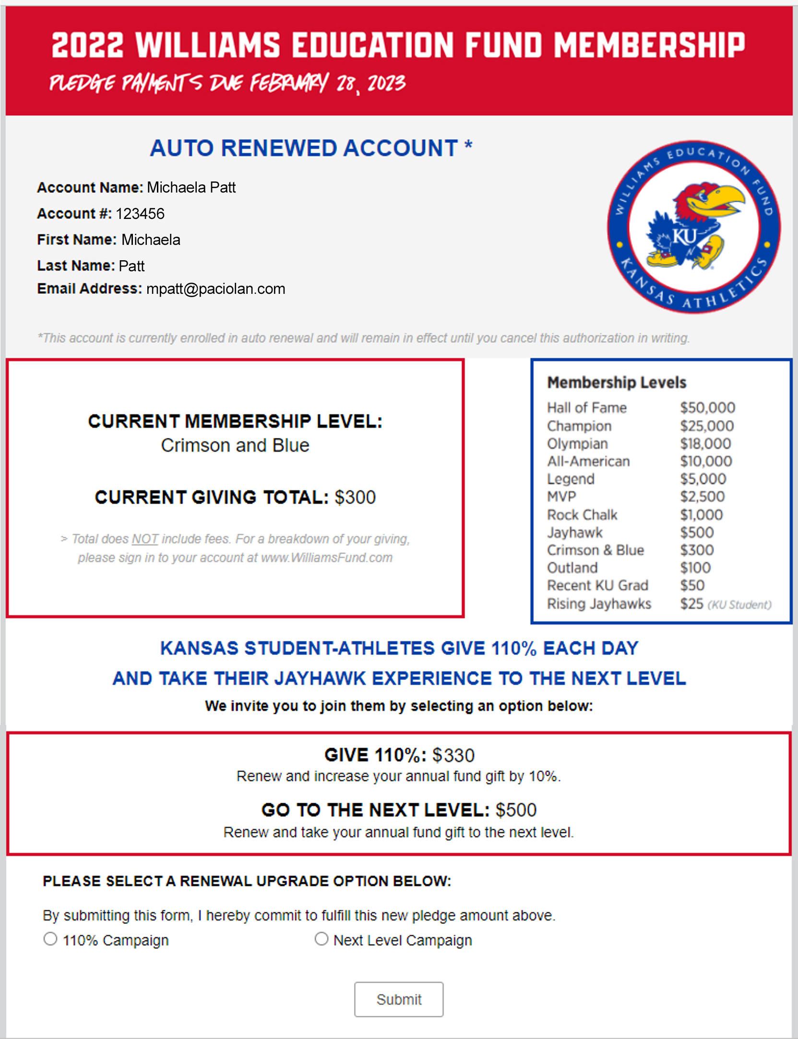
Williams Education Fund
Credit Card Fee & Auto Renew Opt-Ins
Auto Renew Customer
110% & Next Level Opt-In Form

Slide 17
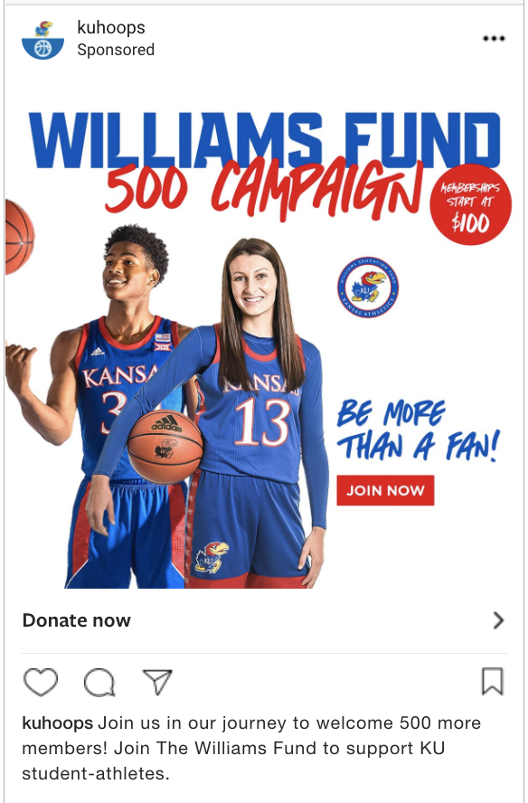
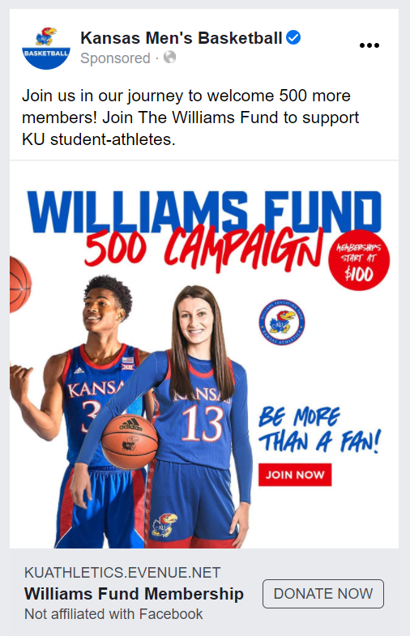
Williams Education Fund
Digital Advertising Utilization Results:
Launched early December
150k impressions
$27k+ revenue generated
$19:$1 ROAS
Instagram
Facebook

Slide 18
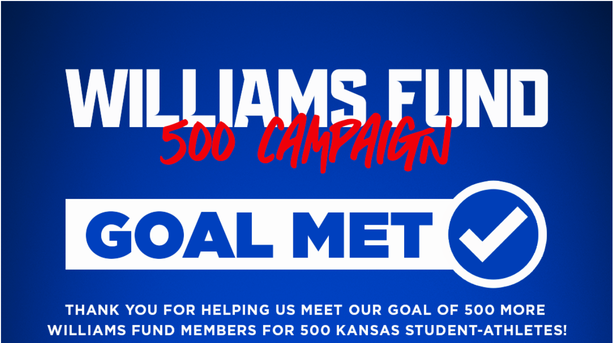
Williams Education Fund
Results:
110% Campaign
  $1.3 million+ revenue generated
  676 account conversions
Next Level Campaign
  $750k+ revenue generated
  198 account conversions
Total revenue (to date):
  $2.1 million revenue generated
Williams Fund 500 Campaign
  Goal exceeded w/ 500+ new donors
  $1.7 million generated to date

Slide 19
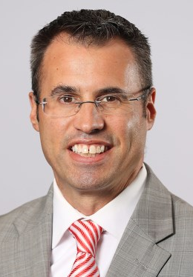
Matt Monroe
University of Maryland
Terrapin Club

Slide 20

University of Maryland
Creating New Benefits:
Terrapin Club+
  Streaming platform implementation
  Initial offer: Five (5) original shows built exclusively for members at Silver level and above ($135)
  Created some unique content to drive new memberships and upgrades to the next giving level

Slide 21
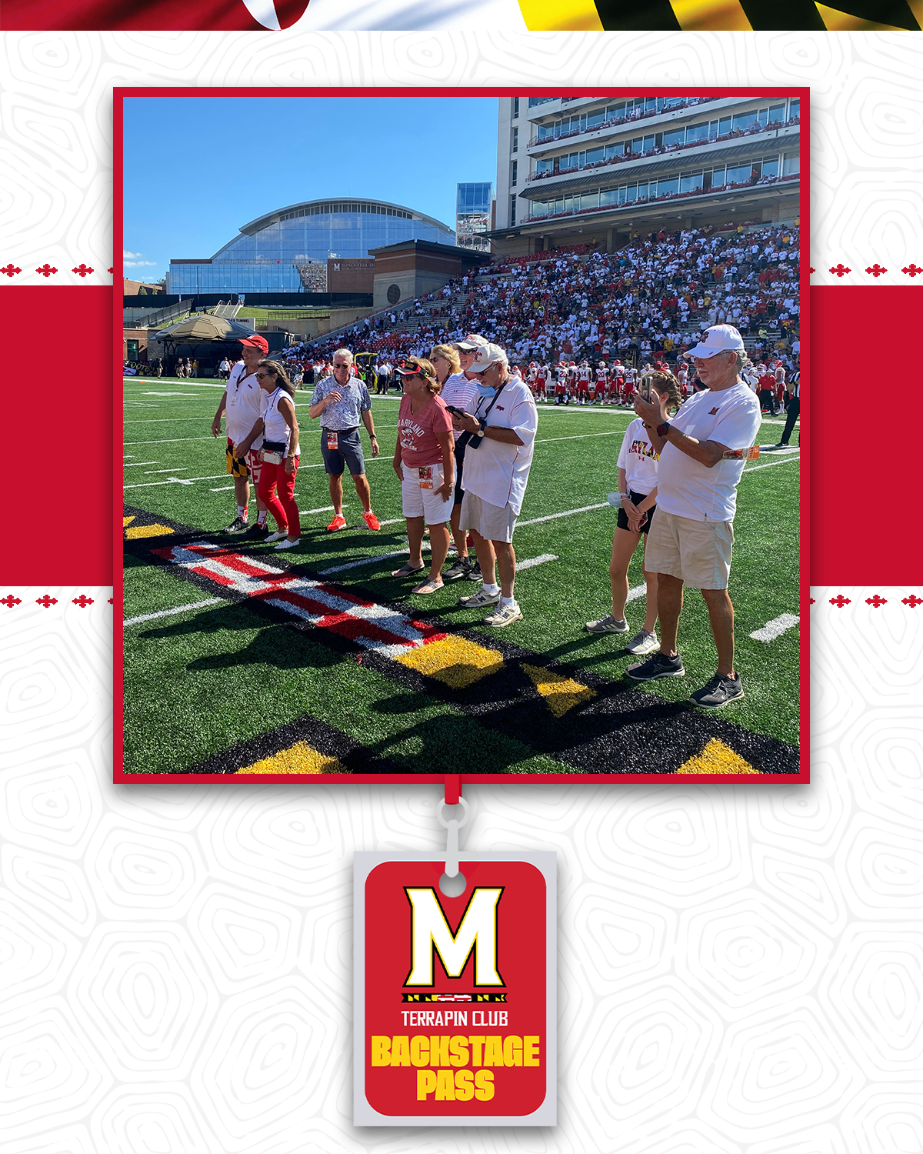
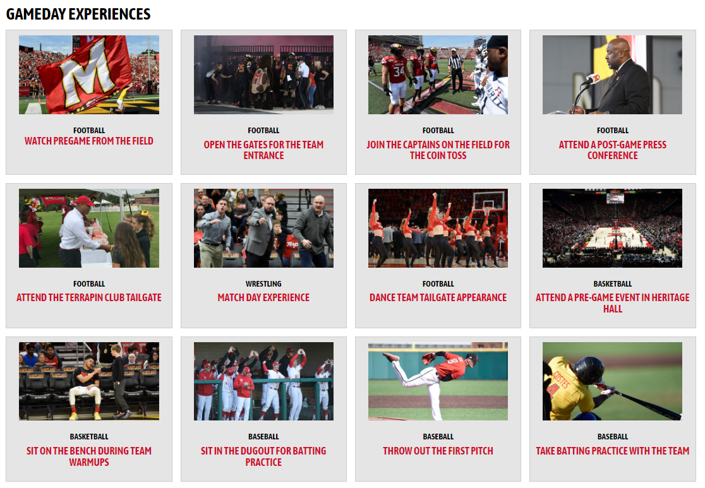
University of Maryland
Creating New Benefits:
Backstage Pass
  Implemented in August 2021 with seven (7) day selection period based on annual giving level & rank
  Various categories & formats of experiences
  1,200+ Experiences selected
  Opportunity:
    Add more experiences & drive donor level upgrades

Slide 22

University of Maryland
Using Milestones & Assets:
Brenda Freese 500th victory
  Women’s Basketball Coach
  February of 2021 launch
  Donate $50 and receive a signed ball commemorating the achievement
75th Anniversary of the Terrapin Club
  May 2021 launch
  6-month promotion to join at $75 and be upgraded to the Silver Level ($135)
  Celebrated our history and donors longevity with social media and print features

Slide 23
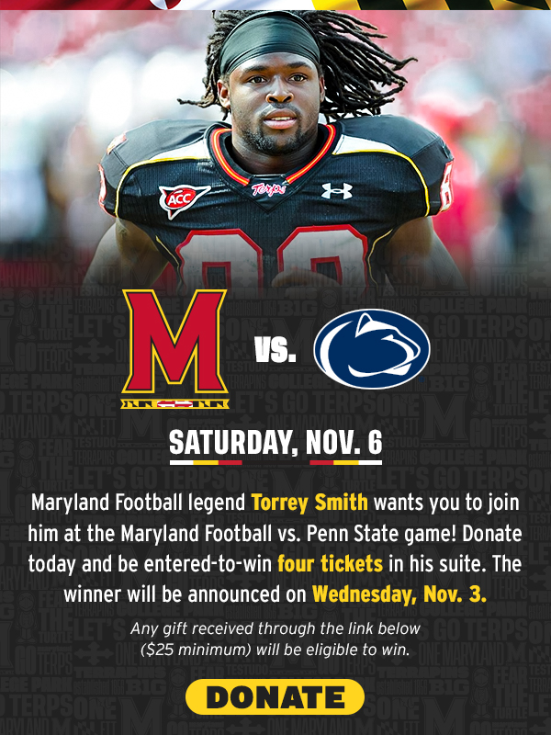
University of Maryland
Using Milestones & Assets:
Torrey Smith Suite Promotion
  Maximize Football Alumni draw
  Sense of urgency
  “Enter to win” approach

Slide 24
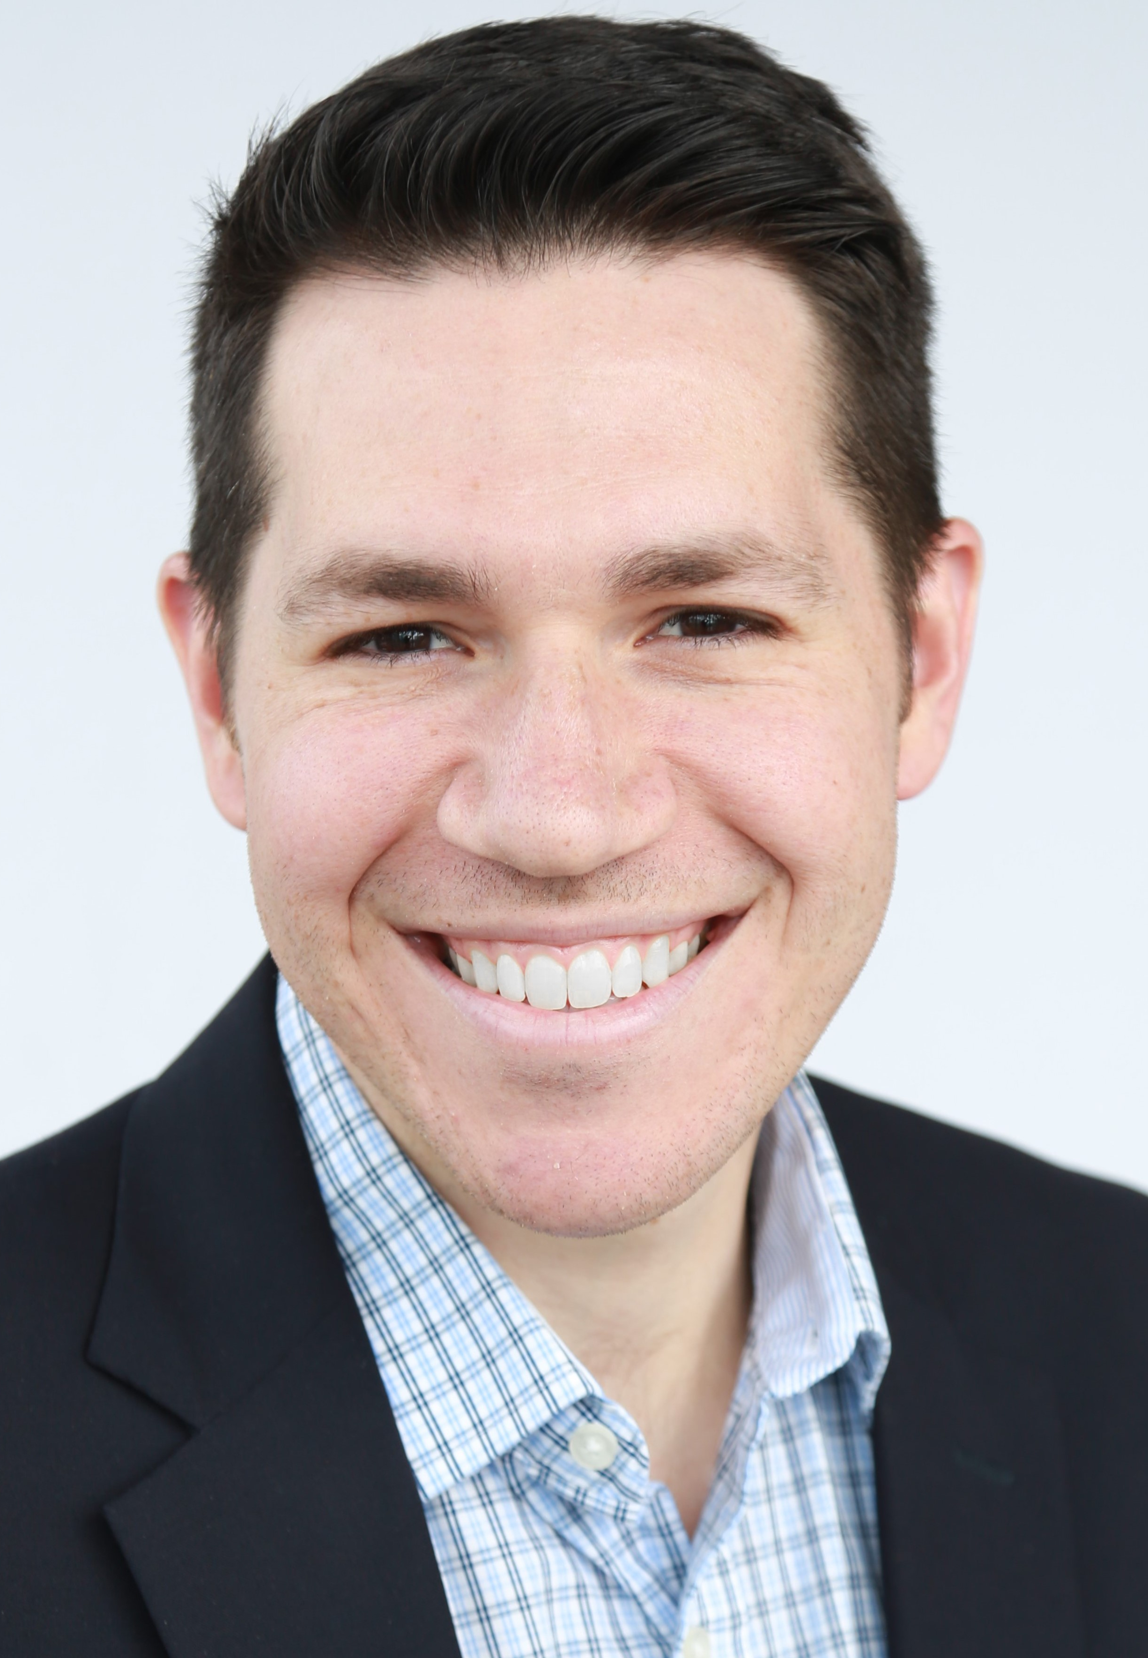
Tyler Reichwein
LEARFIELD Amplify

Slide 25
PHILANTHROPIC GIVING
Major Gifts and
Capital Campaigns
Missing Link
Entry-Level & Mid-Level
Philanthropic Donations
Annual Fund Donations Tied
To Tickets and Parking
Notes:
Colors can be changed to whatever you need them to be.

Slide 26




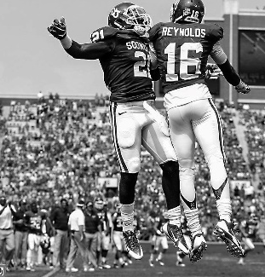
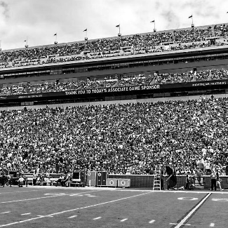
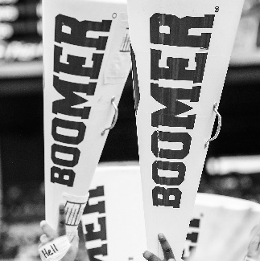
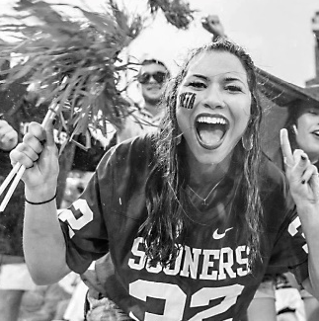

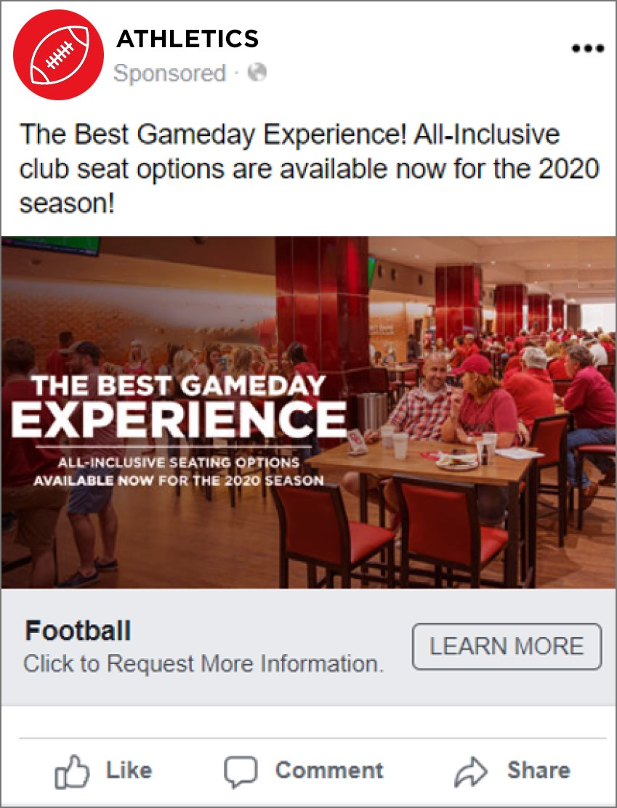
SEGMENTATION
| RESULTS DEVELOPMENT
$2.4M
GENERATED THROUGH FANBASE
SOONER
ELITE
SOONER ESTABLISHED
SOONER FAMILIES
SOONER YOUNG
$100K+
GIFT FOR THE NEXT 5 YEARS
IDENTIFIED SEVERAL
NEW FANS WITH HIGH CAPACITY TO GIVE
| RESULTS PREMIUM SALES
SOLD OUT
PREMIUM TICKET SEATING
in early February
RIGHT OFFER TO THE RIGHT FAN
OVER
70%
YoY sales outpaced by over
800
OF TICKETS SOLD
came from the Fanbase Campagin
NEW SEASON TICKETS

Slide 27
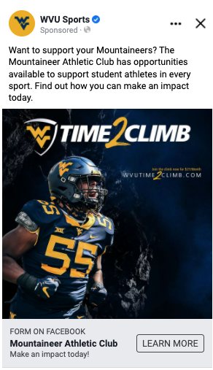

HIGHLY TARGETED CAMPAIGN
Strategy:
Fanbase Data Segments
Ticket Buyers who are not yet donors
A Lookalike of current Donors
Creative & Lead Form
Featured football student athlete
Current Time2Climb campaign
Clear call-to-action to Support Student Athletes.
Qualifying questions in lead form
Notes:
Digital Ads allow us to reach potential donors in new ways.

Slide 28
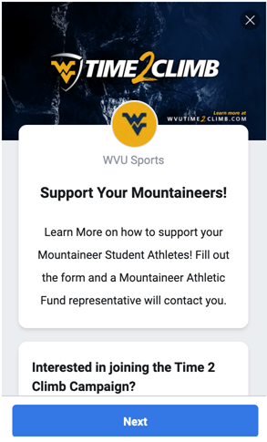
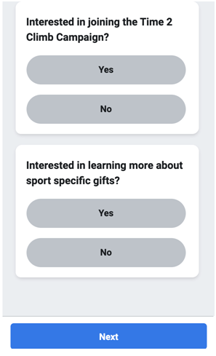
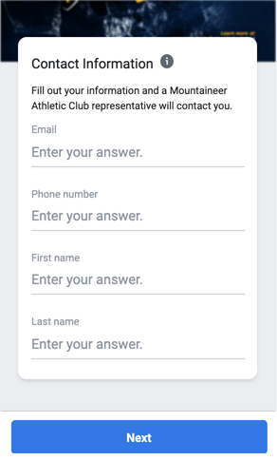
QUALIFYING QUESTIONS

Slide 29
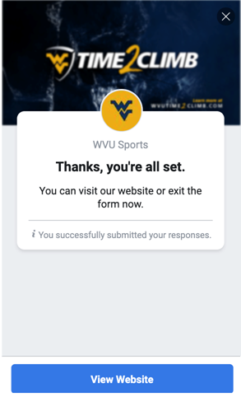
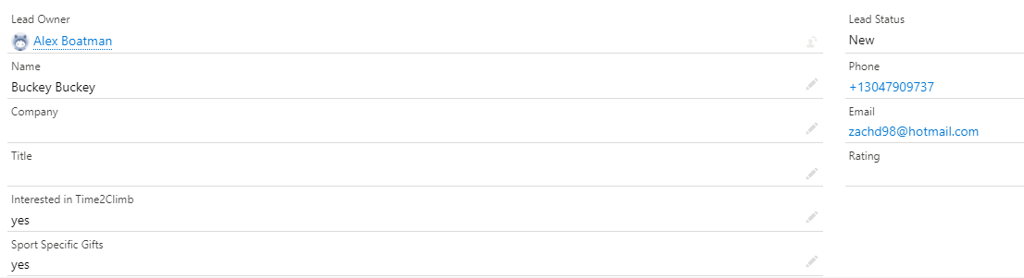
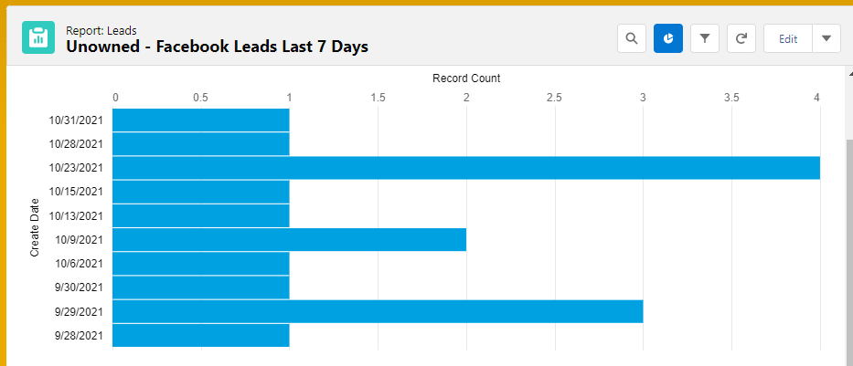
SALESFORCE INTEGRATION
The form is synced with Salesforce to pull the new leads in real time.

Slide 30


SUCCESS STORY
Major Gift Success!
One of the 44 Leads added from Fanbase targeting, converted to a new donor with a $100,000 gift. With a pledge for another $100,000 the following year.

Slide 31
FOLLOW UPS
New Donor Communication Approach
Digital / Mobile Strategy Data Opportunity
Lead Generation Opportunities Ahead
What’s Next?

Slide 32
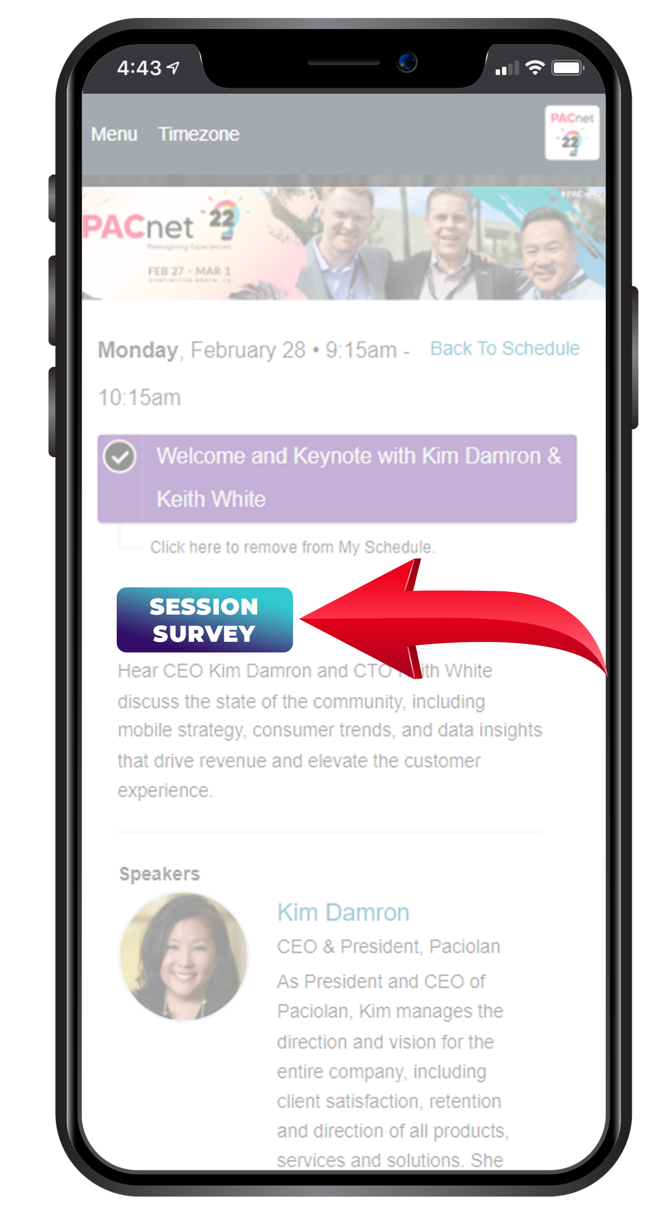
THANK YOU!
QUESTIONS?
Please complete the online session evaluation.

